Slide 1
Smart Shopping Cart System Architecture Name: Manasa Varala Student Id: 11727461 Name: Komatineni Meghana Chowdary Student Id: 11599585

Slide 2
Contents
System Overview
2. Key Components
3. Block Diagram
4. Estimated Power Consumption
5. Communication and Data Processing
6. System Integration Challenges
7. Solutions to Challenges

Slide 3
System Overview Overview A smart shopping cart enhances the shopping experience with automated billing and item tracking. Integrates RFID/barcode scanners, weight sensors, and a microcontroller for item detection and cost calculation. Provides a wireless communication interface for cloud connectivity and mobile app integration. Power & Communication Powered by Raspberry Pi or ESP32 with battery as the primary power source and Wi-Fi for communication.

Slide 4
Key Components
Overview of the main components involved in the Smart Shopping Cart System.
Raspberry Pi/ESP32A
Acts as the main processing unit handling barcode scanning, ML model execution, and user interface management.
QR/Barcode Scanner
Functionality
Captures product information for automatic billing
Process
Scans item QR/barcode, sends data to Raspberry Pi/ESP32, fetches product details from local database, and updates cart details and recommendations.
Display and Battery Pack
Touchscreen Display (7-inch LCD, optional) - Displays real-time cart details and recommendations.
Battery Pack (Lithium-ion, 10,000mAh) - Provides portability and serves as the primary power source.

Slide 5
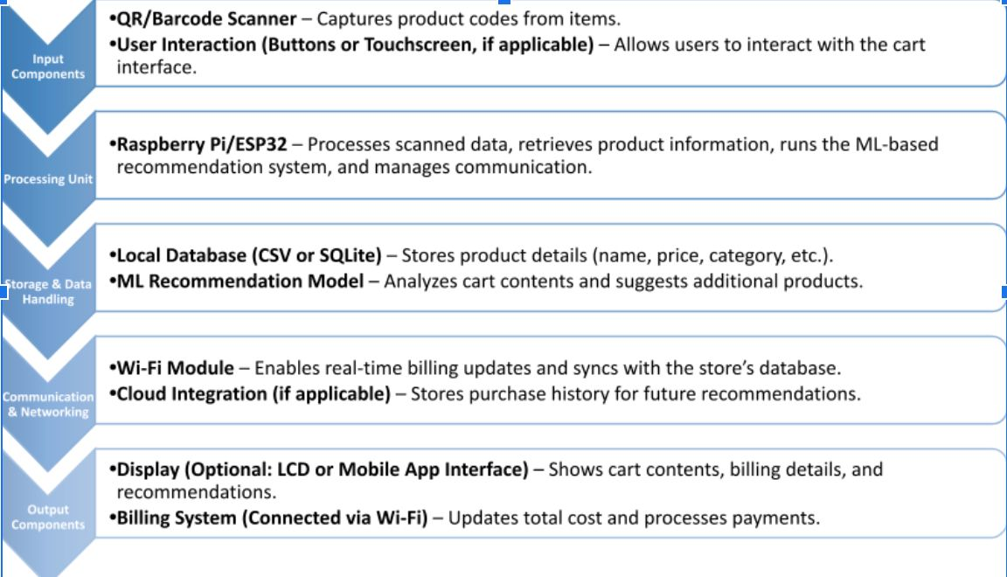
Block Diagram Key components: Raspberry Pi 4 Model B, QR/Barcode Scanner, Touchscreen Display (optional), and Battery Pack. Ensures smooth integration and performance.

Slide 6
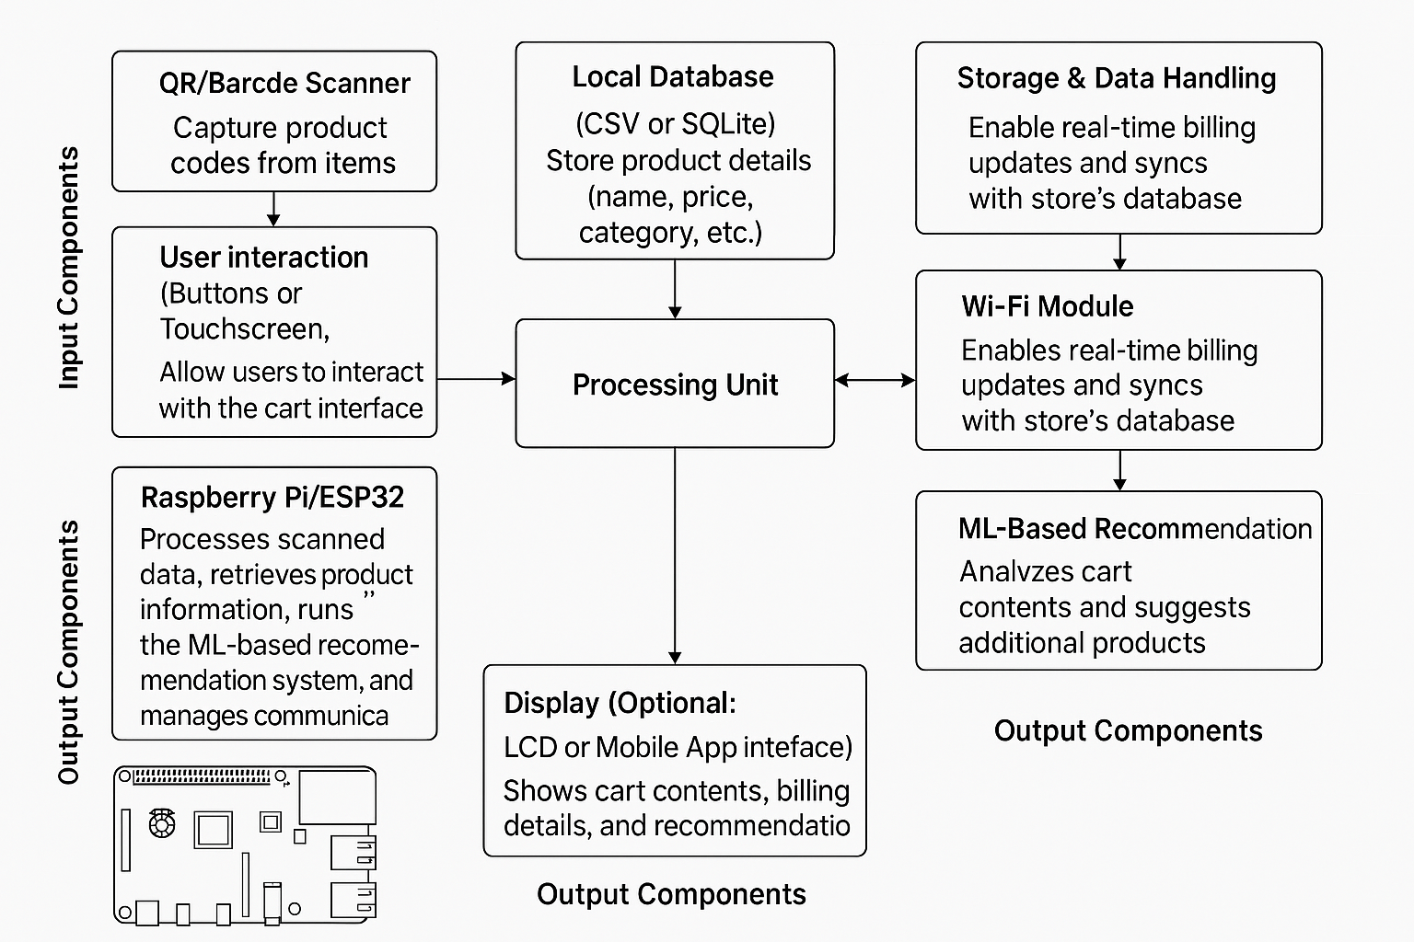
System Architecture

Slide 7
Estimated Power Consumption
Raspberry Pi 4 Model B
3W to 6W depending on processing load.
QR/Barcode Scanner
1.5W power consumption.
7-inch LCD Display
4W if used
Wi-Fi Module
1W power consumption. Total estimated power consumption: 10W-12W.

Slide 8
Communication and Data Processing
Component Communication
QR/Barcode scanner communicates with Raspberry Pi/ESP32 via USB/UART. Wi-Fi module transmits cart updates and billing data.
Data Processing
Raspberry Pi/ESP32 processes scanned data, updates cart details, runs ML model locally for recommendations, and displays information.

Slide 9
System Integration Challenges
Hardware Compatibility
Ensuring all components use compatible communication protocols like USB, UART, I2C.
Power Limitations
Managing power consumption to extend battery life.
Latency & Connectivity
Addressing latency in data processing and handling unstable Wi-Fi connections. Ensuring scanning accuracy.

Slide 10
Solutions to Challenges
Hardware Compatibility: Select components with standardized interfaces and perform integration testing.
Power Optimization: Utilize sleep modes and efficient power management techniques.
Latency Reduction: Optimize data processing algorithms and use local caching for frequently accessed information.
Wi-Fi Reliability: Implement offline mode with synchronization when the connection is restored.
Improved Scanning: Use high-quality scanners with error correction and a manual input fallback option.
Data Security: Encrypt data transmissions and anonymize user data to ensure privacy.

Slide 11
Thank you

